Slide 1
IPT2 user interface customization and locale translation
Alan Yang, Kun Chi Lai, Jim Hsu
Biodiversity Research Center, Academia Sinica

Slide 2
Outline
User Interface Localization
Attesoro
http://attesoro.org/download.html
Customization
Webpage customization
Extension customization (advanced users only)

Slide 3
Getting started
In the case of the IPT all text is kept in a single property file, one for each language. The original is in English and you can translate it into another language.

Slide 4
Getting started
Download the English default properties file from the gbif-ipt project site. http://gbif-providertoolkit.googlecode.com/svn/trunk/gbif-ipt/src/main/resources/ApplicationResources_en.properties
Rename from “ ApplicationResources_en.properties “ to “ApplicationResources.properties”

Slide 5

Using Attesoro
Download Attesoro from http://attesoro.org/download.html
Attesoro is a Java program. If you browse the Internet, you probably have had the Java Virtual Machine installed on your PC; otherwise you can download it from :http://java.com/en/index.jsp.
Once the Java Virtual Machine is installed, with most operating systems, you can run Attesoro by double clicking on its icon.

Slide 6
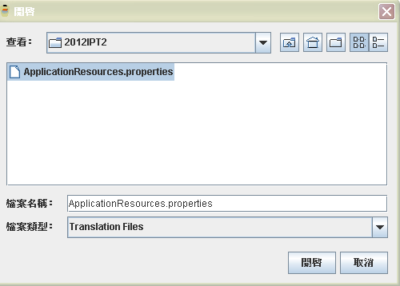
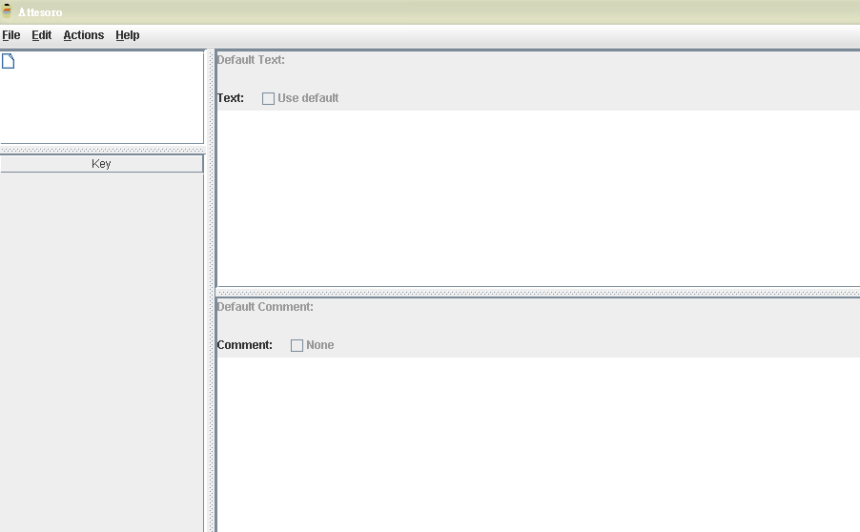
Open default properties file
select the File->Open menu item and open the ApplicationResources.properties file downloaded from the gbif-providertoolkit project site
File Name:
File Type :
open
cancel

Slide 7
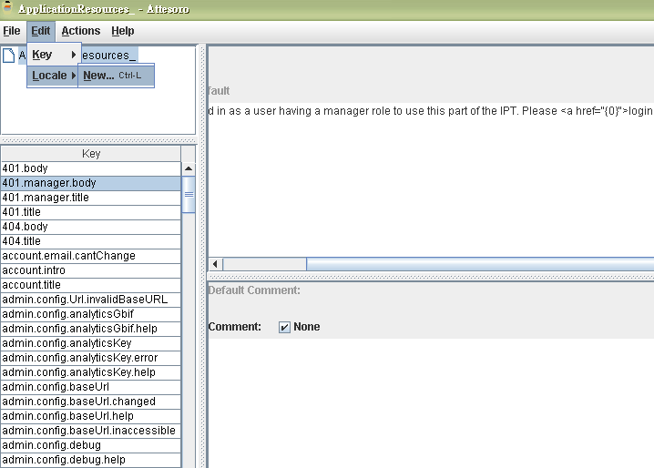
Create your language file
To add a new locale select Locale/New in the Edit menu. Attesoro will display a list of
the possible Locales.

Slide 8
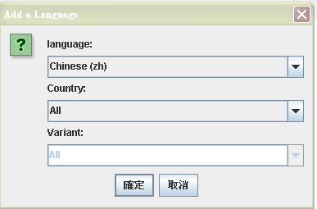
Create your language file
submit
cancel

Slide 9
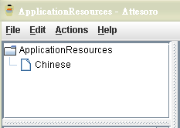
Create your language file
the list of locales

Slide 10
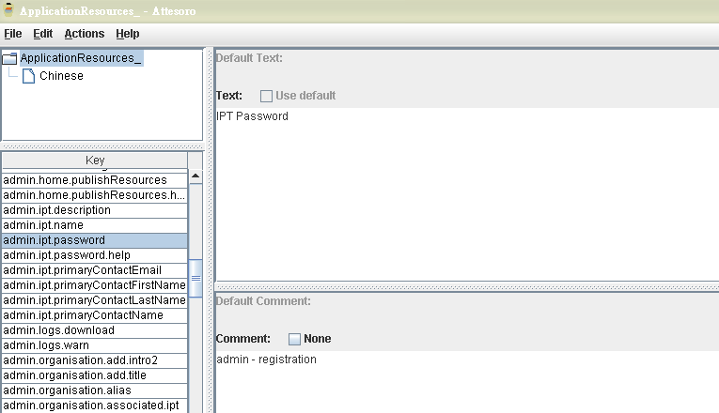
Translate text
Default Text
Select a properties key

Slide 11
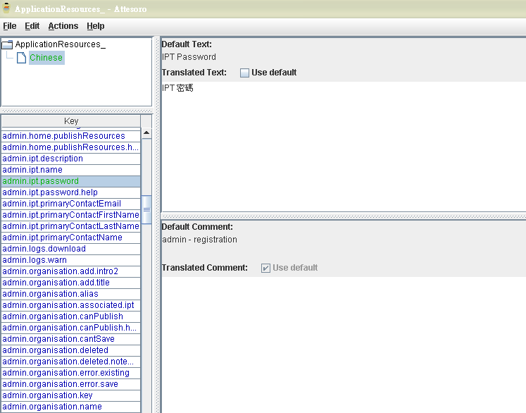

Translate text
Enter or edit the value of the property in the text box

Slide 12
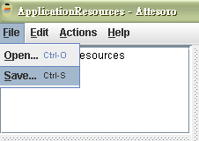

Save Translated File

Slide 13
Interface customization

Slide 14
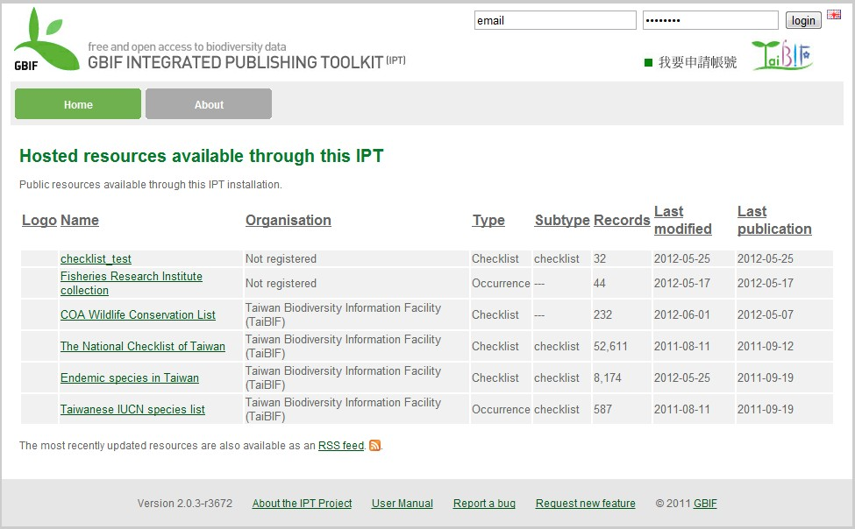
Interface customization

Slide 15
Step1: open the “\WEB-INF\pages\inc” folder under your IPT root folder; then open menu.ftl file.
Step2: modify the source code, like below
<div style="position: absolute; right: 120px; top: 40px; width: 120px;">
<a href="http://taibif.org.tw/ipt_apply/apply.php"><img src="http://taibif.org.tw/ipt/styles/getaccount.jpg"></a>
</div>
<div style="position: absolute; right: 15px; top: 40px; width: 100px;">
<a href="http://taibif.tw/">
<img src="http://taibif.org.tw/ipt/styles/taibif.jpg"></a>
</div>

Slide 16
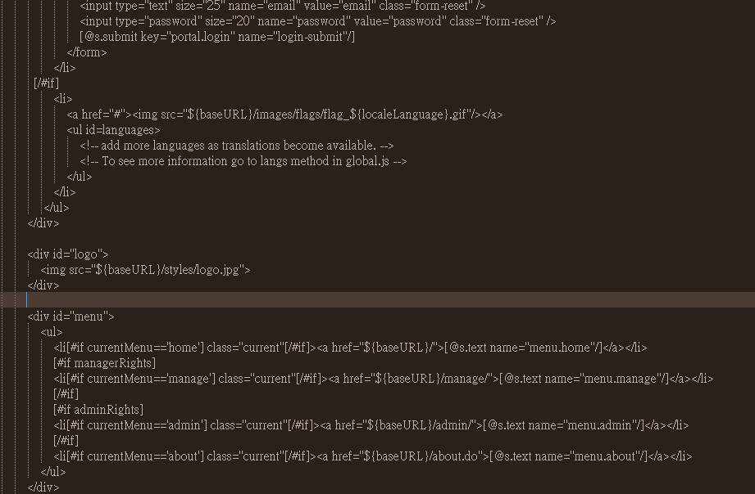
Insert html code

Slide 17
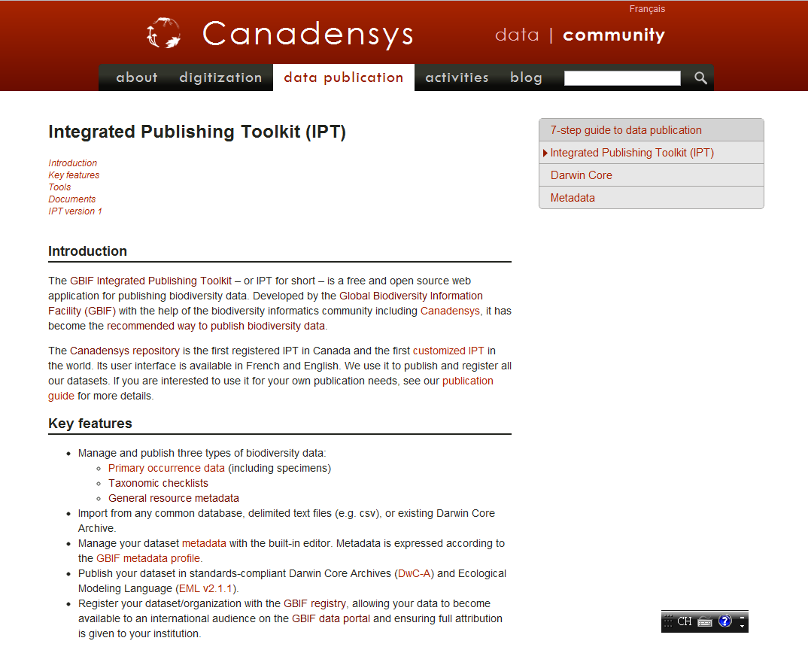
The Canadensys repository is the first registered IPT in Canada and the first customized IPT in the world.

Slide 18
Advanced users
Requirements
Java SE
Apache maven
TortoiseSVN
Software development environment
Eclipse
Download source code
Command-line access
svn checkout http://gbif-providertoolkit.googlecode.com/svn/trunk/ gbif-providertoolkit-read-only

Slide 19
Installing Maven
Add the bin directory to your PATH, eg:
Windows 2000/XP
set PATH="c:\program files\apache-maven-3.0.x\bin";%PATH%
Make sure JAVA_HOME is set to the location of your JDK
JAVA_HOME
C:\Program Files\Java\jdk1.6.0_25\jre

Slide 20
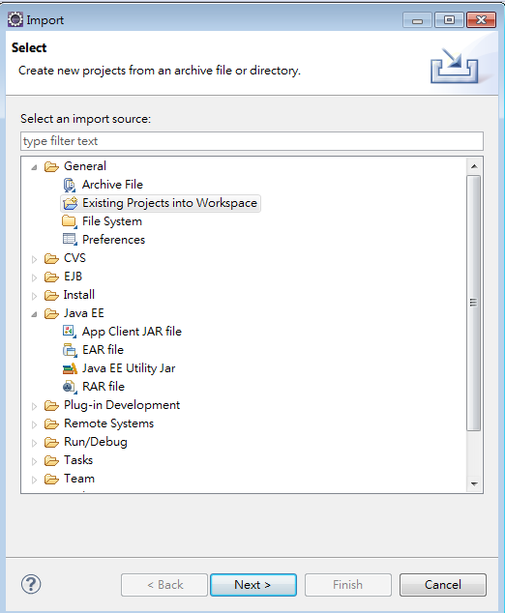
Using Eclipse to import the IPT Source code

Slide 21
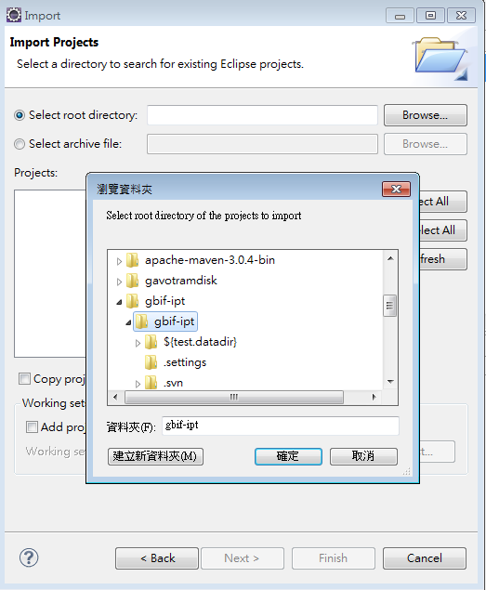
Select the source code folder

Slide 22
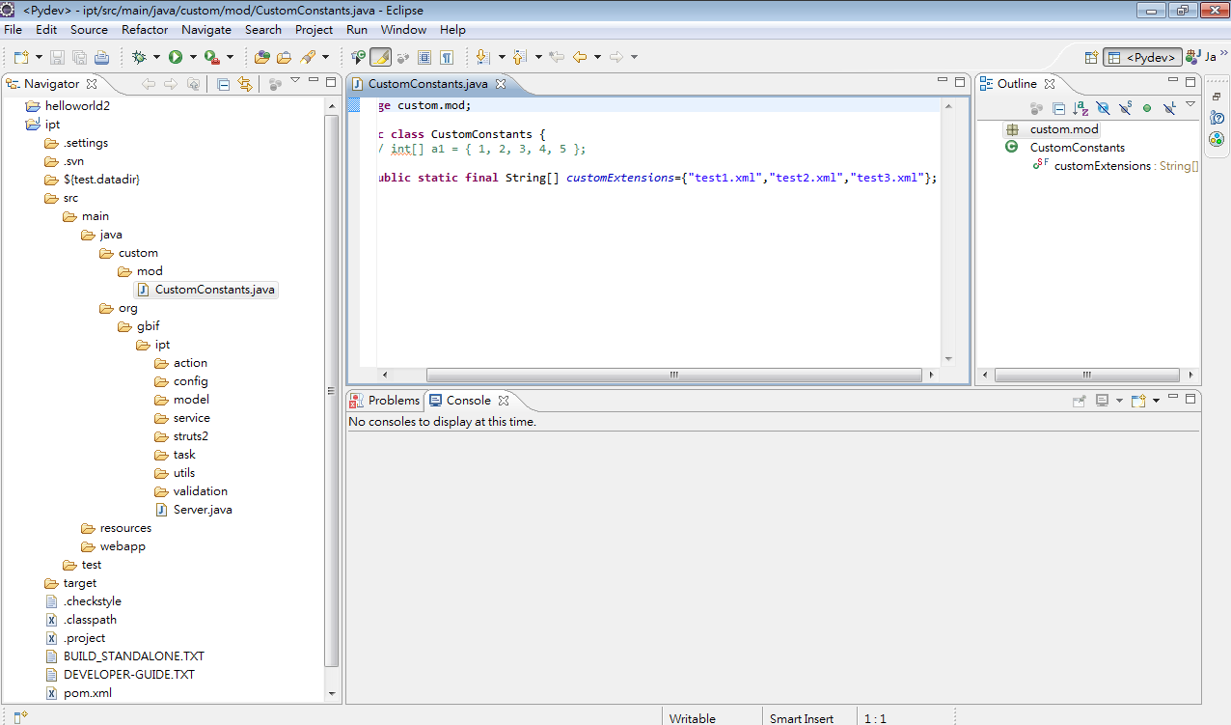

Slide 23
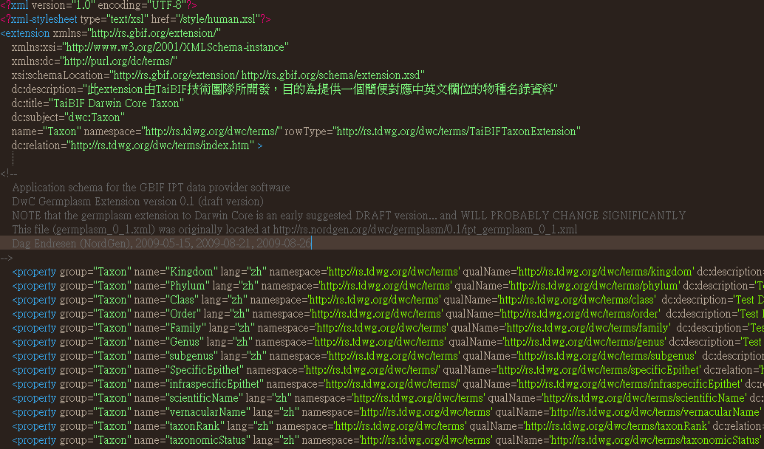

Slide 24
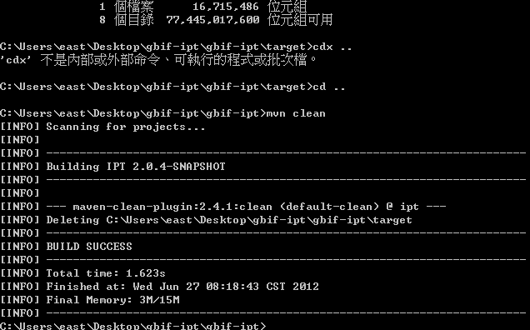
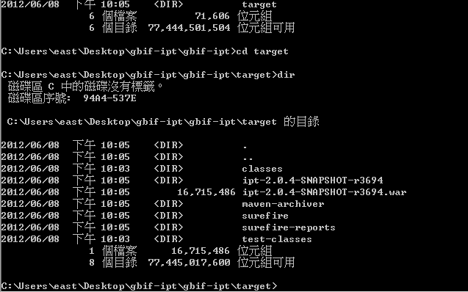
Run the following command in a Terminal window
mvn clean //clean all cache
mvn package //create a new war file
Before reinstalling the IPT, you have to backup your IPT Data folder.

Slide 25
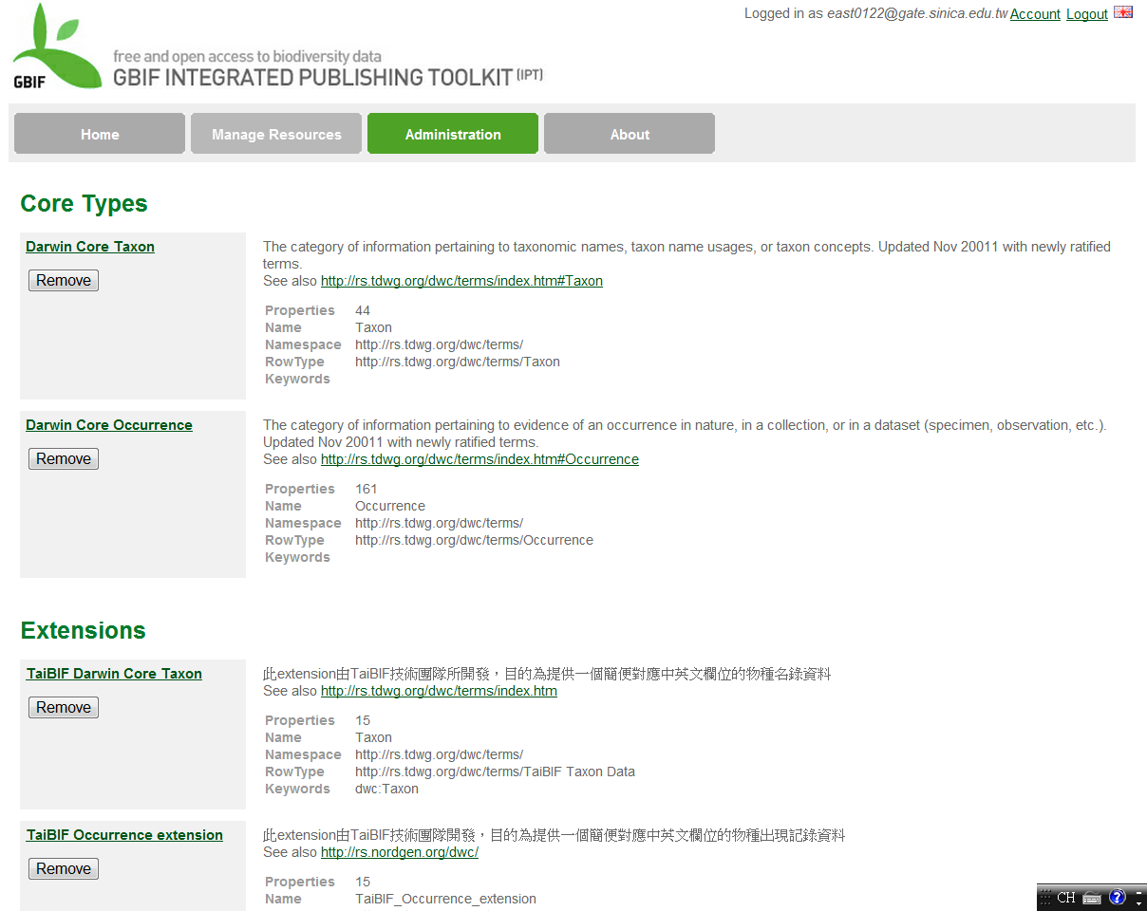

Slide 26
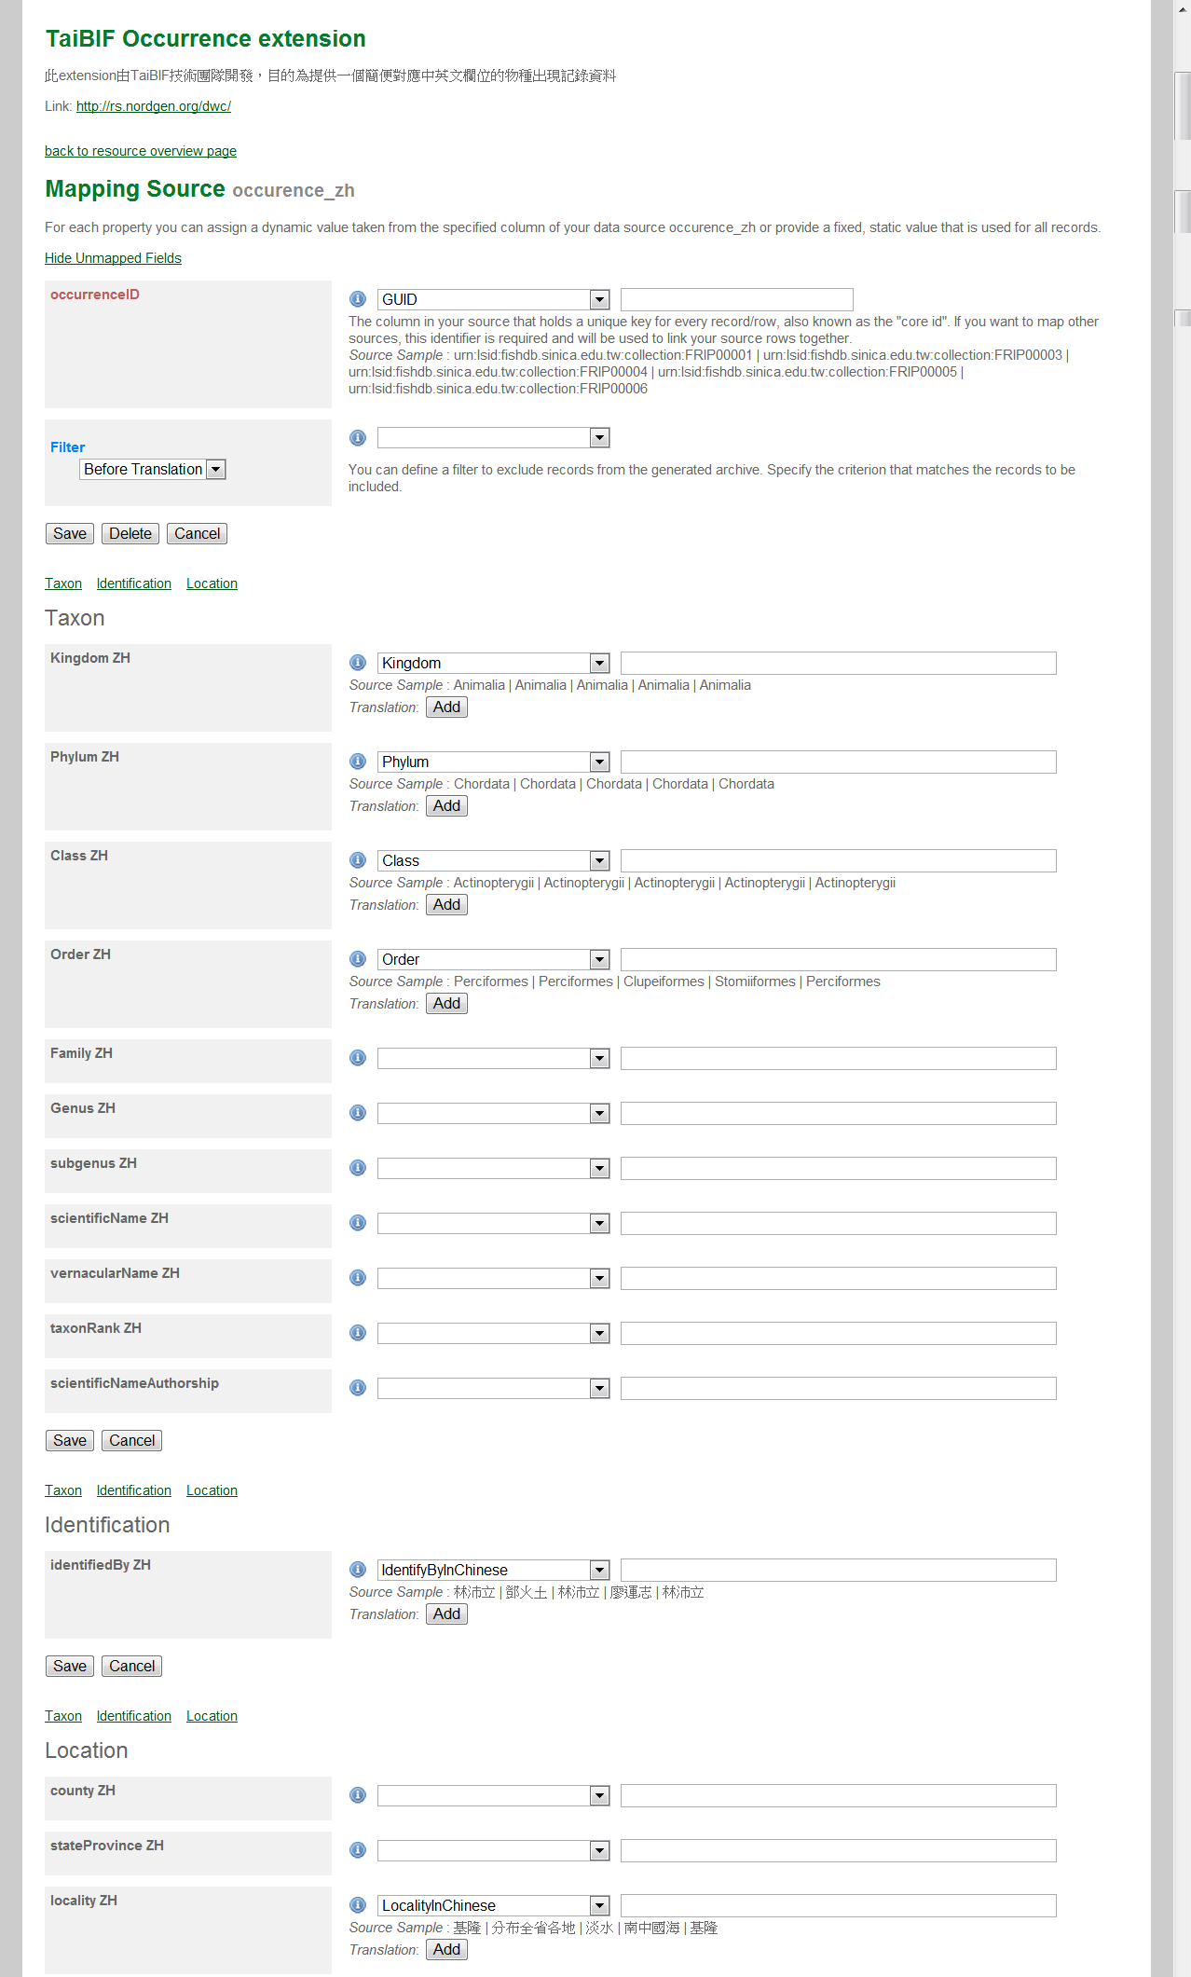

Slide 27
Thank You!
http://taibif.tw

